Slide 1
Essential statistics for data science
Francesco Bellotti, Univ. Genova

Slide 2
Essential statistics
Get to know some of the essential statistics you should be very familiar with when learning data science
https://www.learndatasci.com/tutorials/data-science-statistics-using-python/
Why some schools are under-performing?
Literature review
Data collection
Low school rating

Slide 3
Two main types of statistics
Descriptive statistics identify patterns in the data, but they don't allow for making hypotheses about the data.
Within descriptive statistics, there are two measures used to describe the data: central tendency and deviation.
Inferential statistics allow us to make hypotheses (or inferences) about a sample, that can be applied to the population.
Hypothesis testing
Mean value, distribution, etc.

Slide 4
Measurements are variables that can be quantified.
Variables can be put into two classes: outcomes and indicators.
Outcomes (e.g., test scores) cannot be used to explain one another.
The second class, indicators, are used to explain our outcomes.

Slide 5
Describe
Describe() on the whole dataframe to see statistical descriptors of the columns
Describe() on the target column + a possible good indicator, grouped by the target column
Count
Mean: mean value of the variable (i.e., indicator) in each group
min: the minimum value of the variable (in each group)
25%: the value of the variable at the first quartile (in each group)
50% median

Slide 6
Corr
Check the correlation between two variables

Slide 7
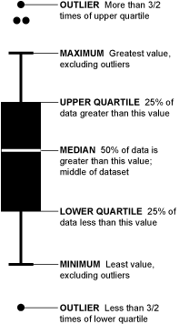
Box-and-Whisker Plot
https://flowingdata.com/2008/02/15/how-to-read-and-use-a-box-and-whisker-plot/
Or another threshold
Pd.DataFrame has boxplot() capability

Slide 8
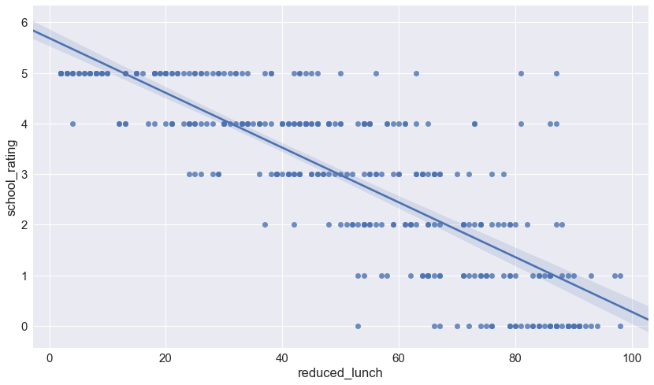
RegPlot
Plot the relevant features
Seaborn regplot
Plot data and a linear regression model fit.

Slide 9
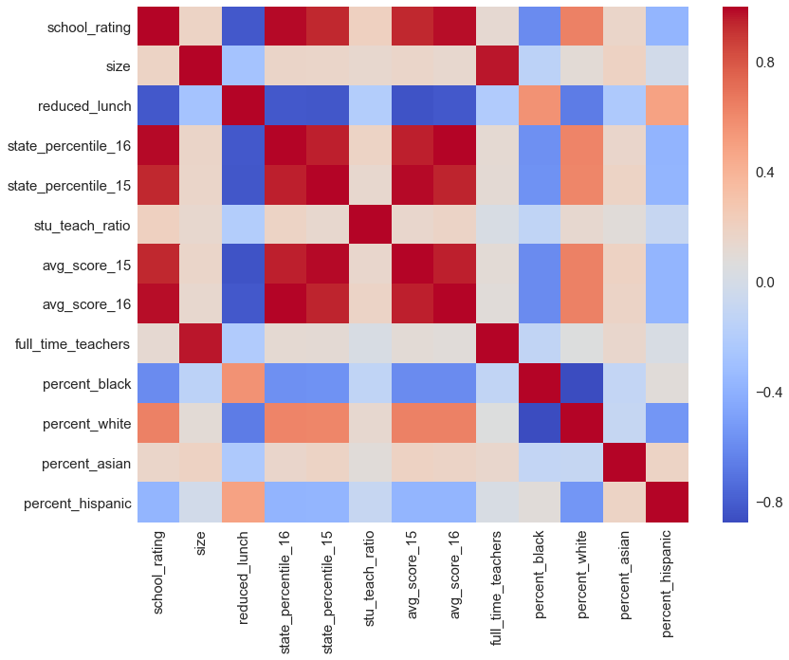
Correlation analysis
With a heatmap
corr = Dataframe.corr() seaborne heatmap(corr, etc.)

